Slide 1
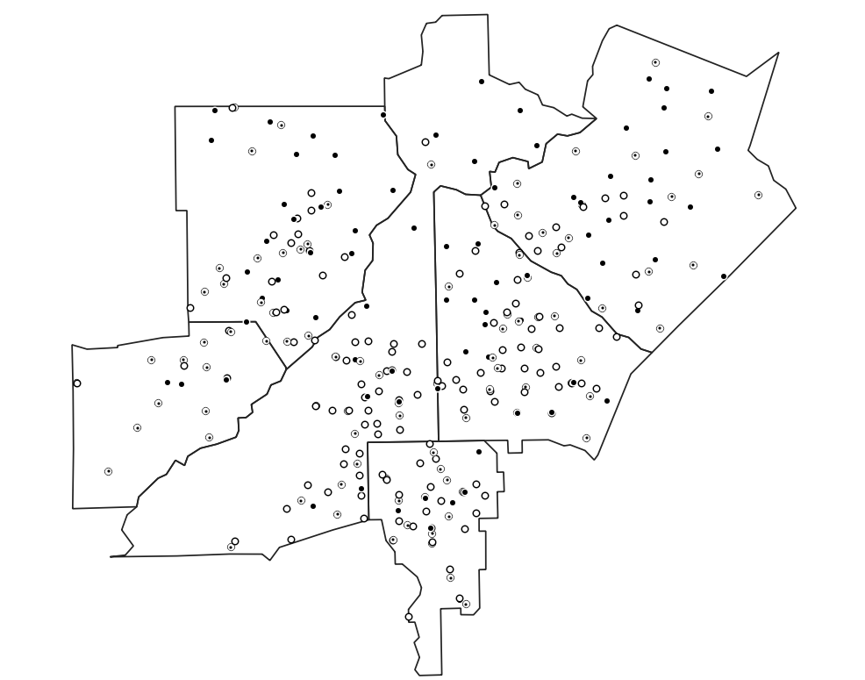
Week 5: Spatial data; Point pattern analysis
Geog4300: Harper

Slide 2
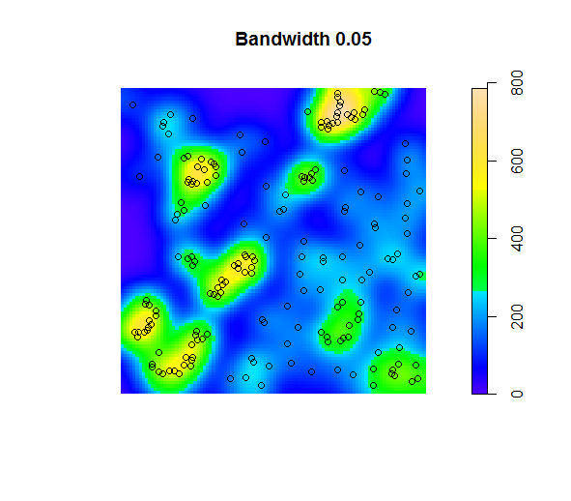
This week: Describing spatial data
Point pattern analysis
Mean center
Nearest neighbor index
Kernel density
Location quotient
Quadrats
MAUP

Slide 3
Vector and raster data – which is which?

Slide 4
Vector and raster data
vector
raster
RASTER DATA:
Comprised of raster cells—all the same size and all with a value
VECTOR DATA:
A representation of the world using points, lines, and polygons. Vector models are useful for storing data that has discrete boundaries, such as country borders, land parcels, and streets.
Terminology comes from GIS. I worked with climate data for >10 years before coming across these terms!

Slide 5
Vector vs raster data

Slide 6
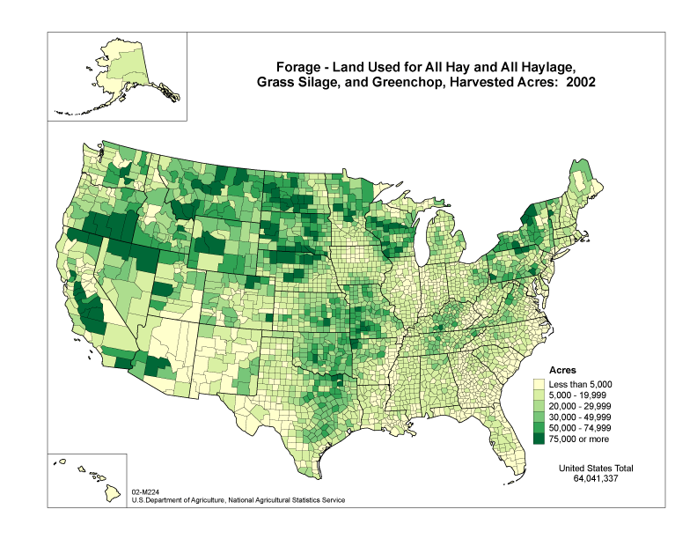
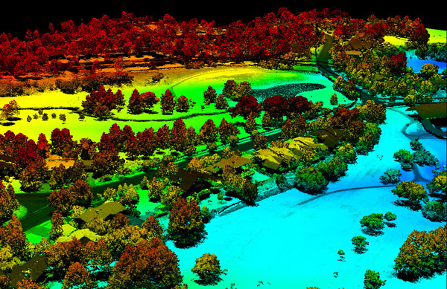
Are these vector or raster?
3dgolfcourse.com
Notes:
What makes data geographic?
Wide variety of data sources and methods
Raster and vector based data sources
Information about a place in some form—often now through GIS based techniques
RASTER DATA:
Comprised of raster cells—all the same size and all with a value
VECTOR DATA:
A representation of the world using points, lines, and polygons. Vector models are useful for storing data that has discrete boundaries, such as country borders, land parcels, and streets.
(Jerry uses vector data, I use raster but I don’t call it that)

Slide 7
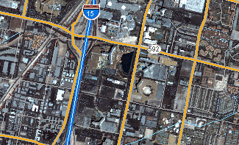
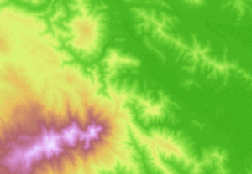
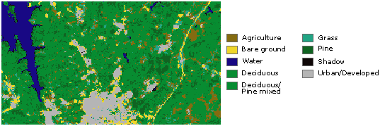
Continuous data
Basemaps
Thematic (discrete) data
Notes:
In its simplest form, a raster consists of a matrix of cells (or pixels) organized into rows and columns (or a grid) where each cell contains a value representing information, such as temperature. Rasters are digital aerial photographs, imagery from satellites, digital pictures, or even scanned maps.
Data stored in a raster format represents real-world phenomena:
Thematic data (also known as discrete) represents features such as land-use or soils data.
Continuous data represents phenomena such as temperature, elevation, or spectral data such as satellite images and aerial photographs.
Pictures include scanned maps or drawings and building photographs.
Common raster maps? Temperature data (interpolated), land cover, classified remote sensing imagery
Questions you could ask of a land cover map—what percentage of an area is covered by various land cover types. What’s the relationship between type of land cover and other characteristics: elevation, proximity to certain features, etc.?

Slide 8
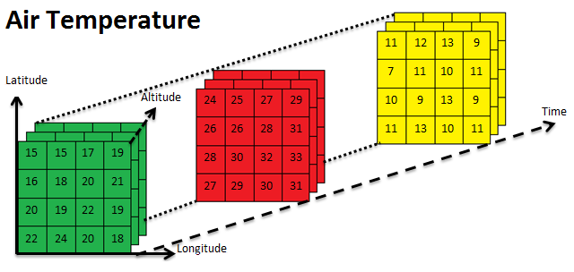
Arrays (multi-dimensional)

Slide 9
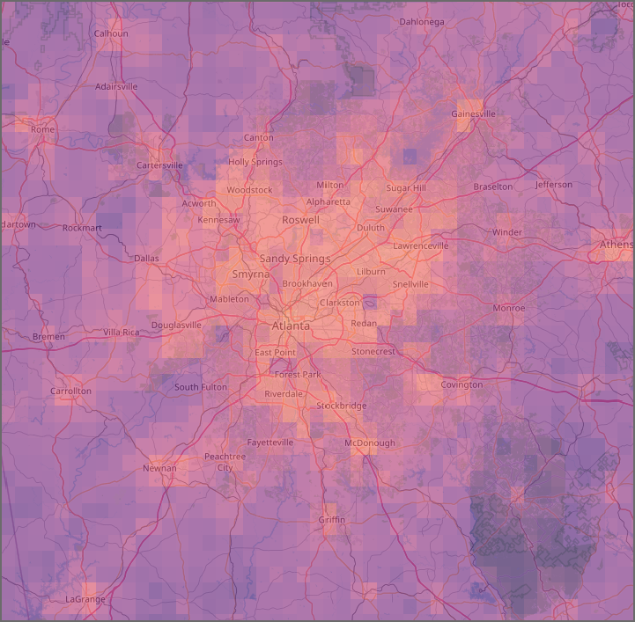
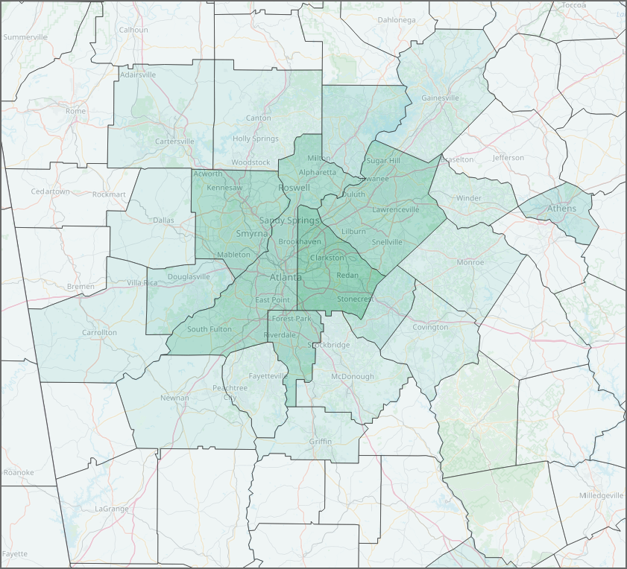
Spatial data 101: Vector and raster data
Two maps of population density
Notes:
Vector data:
Geometric shapes: Points, lines, and polygons.
Defined by vertices
Usually irregular in shape.

Slide 10
Spatial data 101: File types
Vector: Shapefile, GeoJSON, KML, Geopackage, CSV, XLX,…
Raster: GeoTIFF, NetCDF, etc.
Notes:
GeoTIFF: TIFF image with coordinates attached.

Slide 11
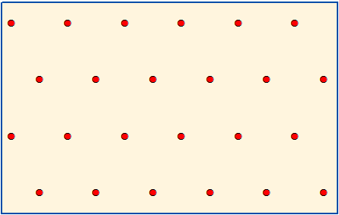
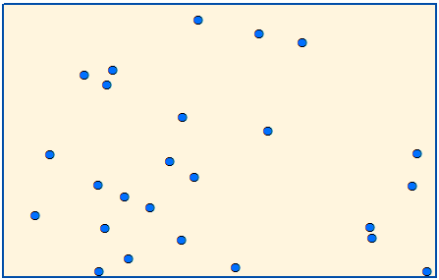
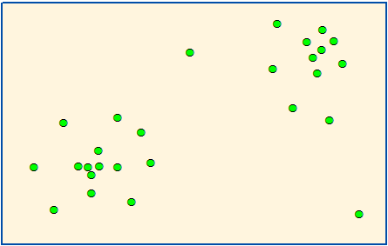
Point pattern analysis
How do we identify patterns in the distribution of point data?
Clustering and dispersion of point data
Distribution of point incidents (disease, natural disasters, species, crime, etc.)
Relative frequency of subevents (strong tornadoes, particular disease variants, etc.)
Notes:
Locational vs attributes.

Slide 12

Nearest Neighbor Index
$$\frac{Actual average distance}{Distance for random distribution}$$
Notes:
How clustered are the points?
If this is >1 what does it tell you?
Actual average distance > random → spread out.
If <1 → closer together.
Turn to neighbor and discuss which is which?
Blue: Random
Red: Dispersed – like magnets pushing each other apart.
Green: Clustered
This is a global measure – it’s describing the whole data set, not individual points.

Slide 13
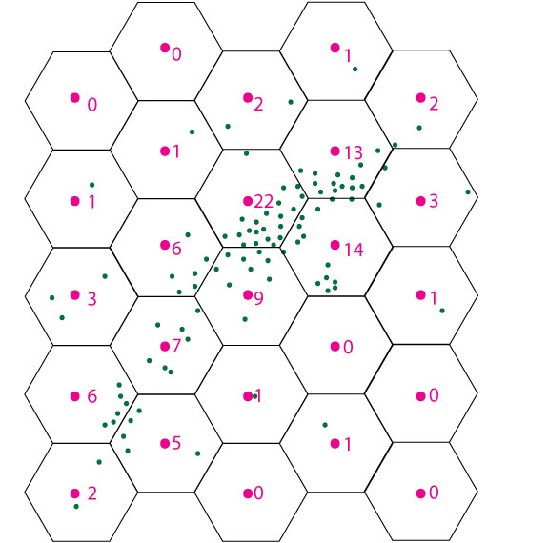
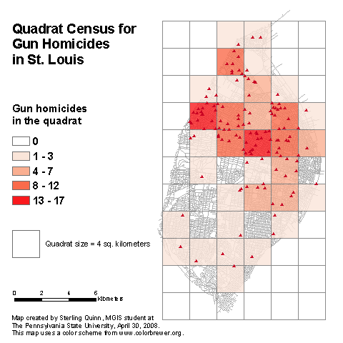
Quadrats
Aggregating points to a tessalated grid, usually squares or hexagons
Notes:
Quadrats:
Looks a little like raster.
Tessalation = ? A shape that’s repeated over and over.
Aggregate points into a grid. Enables quantification of the distribution of the data points.

Slide 14
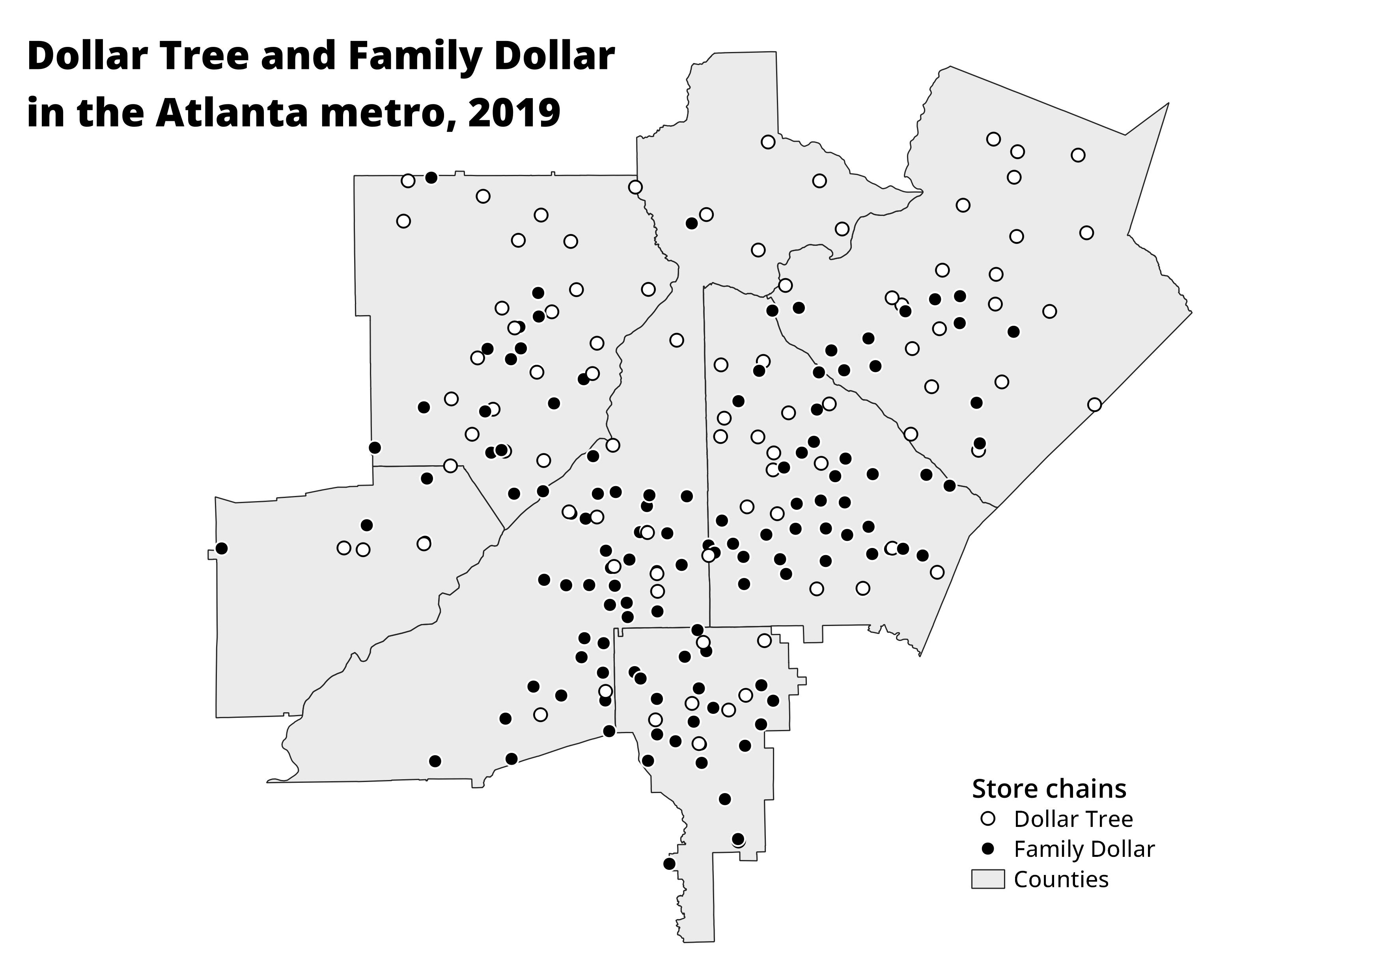
Let’s try it!
Dollar stores in Atlanta
Create a quadrat grid of 1.5 or 3 inch squares
Count the total stores for each chain in each grid cell
Notes:
Work sheets and rulers:
Dollar stores in Atlanta.
Make a grid. Count the stores in each grid cell.
Make a table with cell index, FD, DT, total

Slide 15

Location quotient
Relative incidence of a particular event
Pick a chain and count just those points
What is the percentage of all stores for each grid cell?
$$LQ=\frac{{pct}_{subarea}}{{pct}_{area}}$$
For the whole area:
Dollar General: 31% (93/305)
Dollar Tree: 28% (86/305)
Family Dollar: 41% (126/305)
Notes:
Rate in a sub-area compared to rate in a whole area.
e.g. how many tornadoes in Minnesota compared to entire Midwest? (30% in Minn vs 20% in Midwest).
When is this useful?
It’s a form of hotspot analysis – when is something happening more often in a certain area.
Severe vs mild disease maps.
% of trees with an insect infection in a subarea compared to larger region.
e.g. 41% of stores are FD, but in each grid you’ve just created the % will be different.
LQ < 1 means the rate is lower than the region average.
LQ > 1 means the rate is higher than the region average.

Slide 16
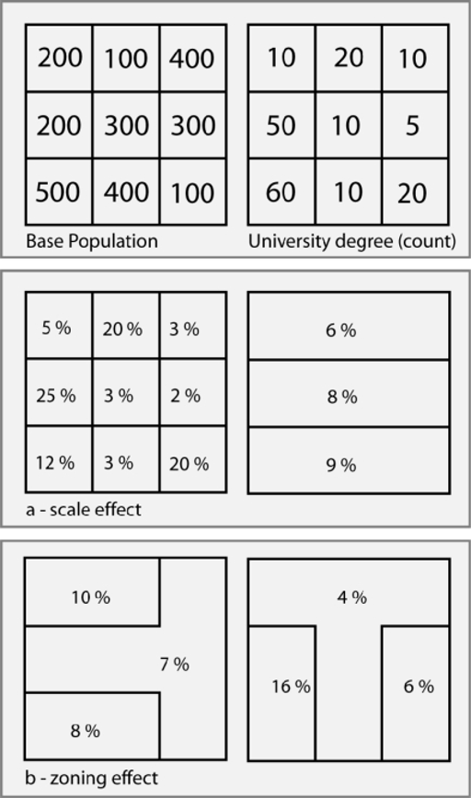
The Modifiable Areal Unit Problem
How did our quadrat maps vary?
Notes:
MAUP:
Gerry-mandering – you change the boundaries and get different results!
Where are the hotspots for atl metro area? People might get slightly different answers because of MAUP.

Slide 17
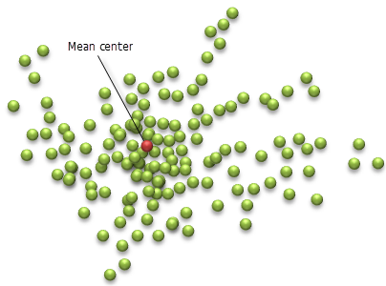
Mean center
What is the average X/Y coordinate of each point?
Open the dollarstores_atlcore CSV file in Excel/Sheets (file is in the repo)
What’s the mean X and Y coordinate for each store chain?
Where are each of those points located?
What does this mean?

Slide 19
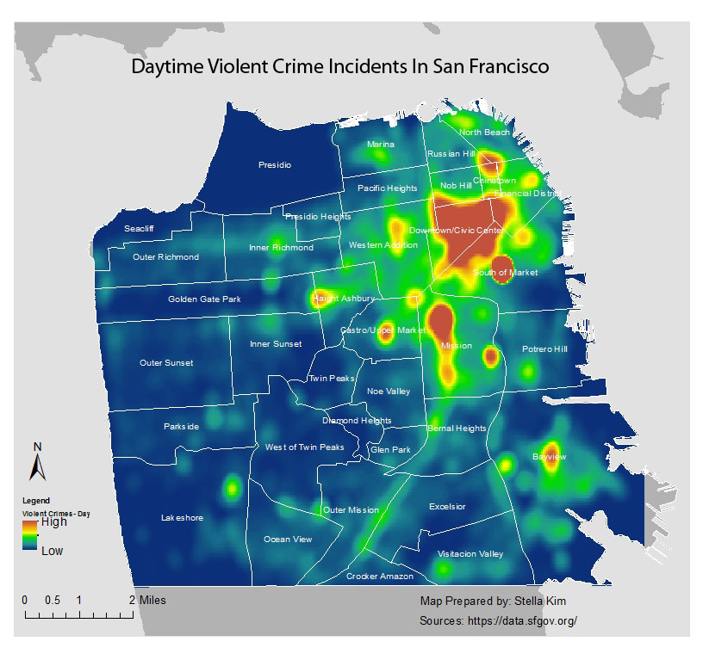
Kernel density estimation

Slide 20
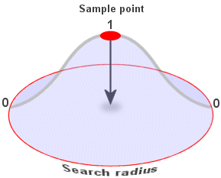
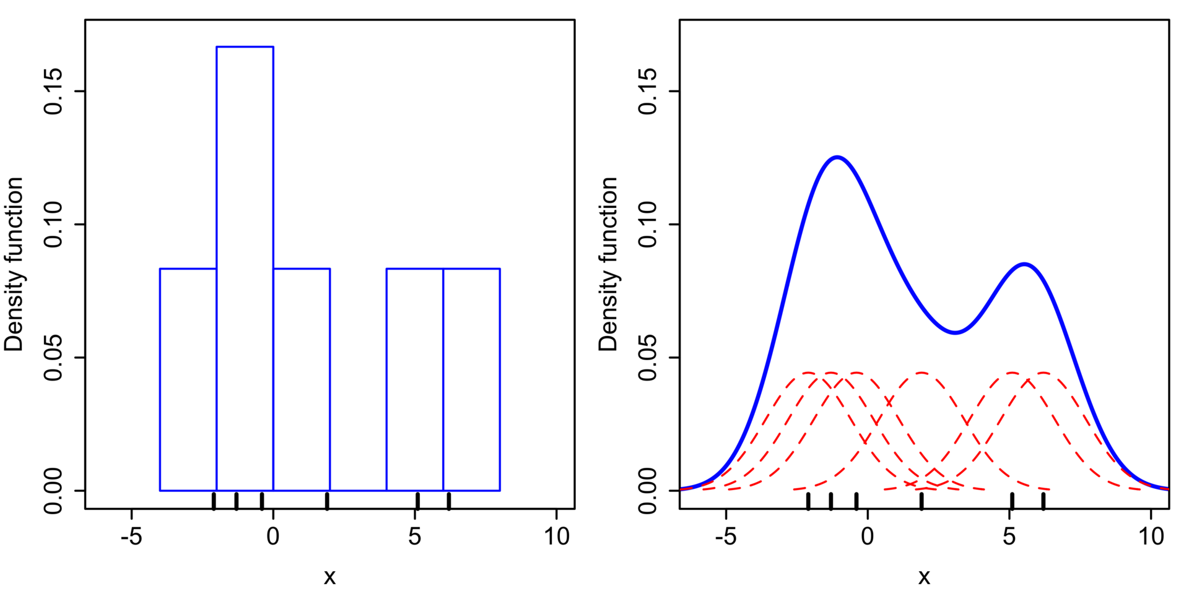
Kernel density estimation

Slide 21

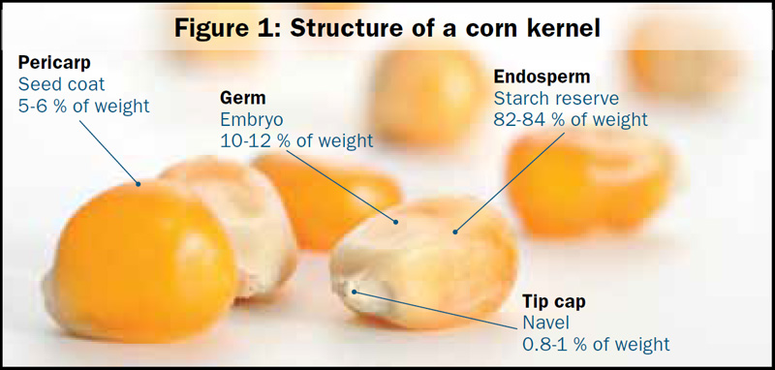
Problems with kernel density estimation
Fuzzy estimates rather than precise points
Influential outliers

Slide 22
Lab 2
Mapping reported crime in Spokane, WA
Mean centers by type of offense
Calculating crime rates by precinct
Calculating the LQ for burglaries
Bonus: Creating a quadrat map

